Slide 1
Bol en Knol gewassen
Toets

Slide 2
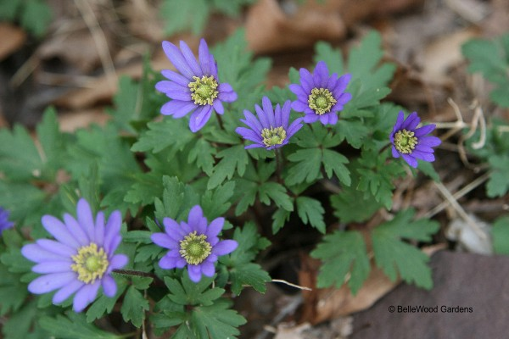
Anemone blanda 'Blue shades'

Slide 3
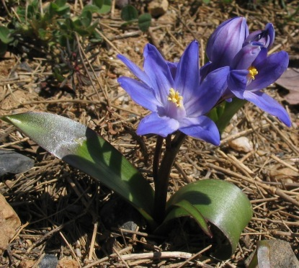
Chionodoxa luciliae

Slide 4
Crocus tommasinianus

Slide 5
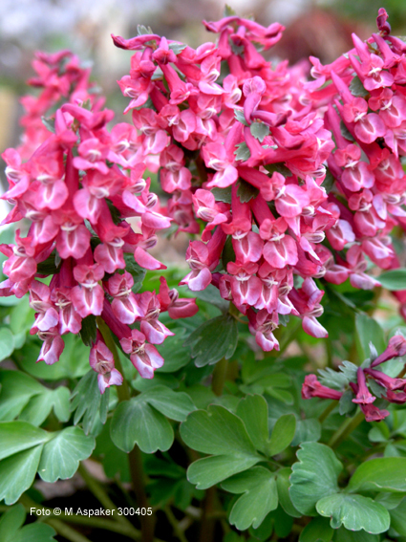
Corydalis solida

Slide 6
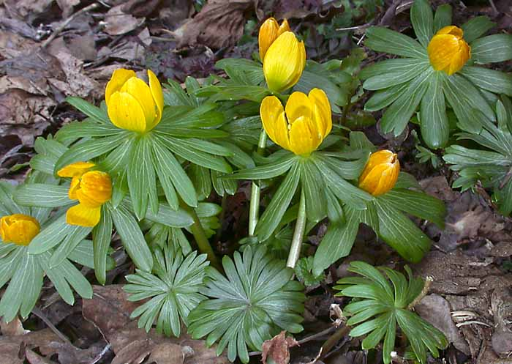
Eranthis hyemalis

Slide 7
Fritillaria imperialis

Slide 8
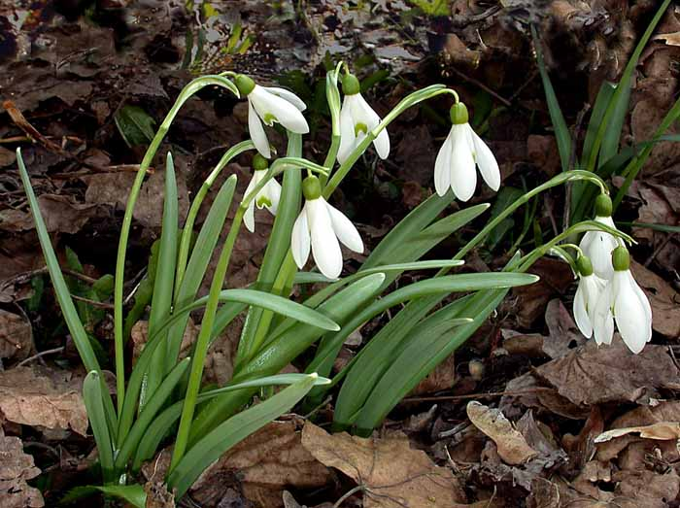
Galanthus nivalis

Slide 9
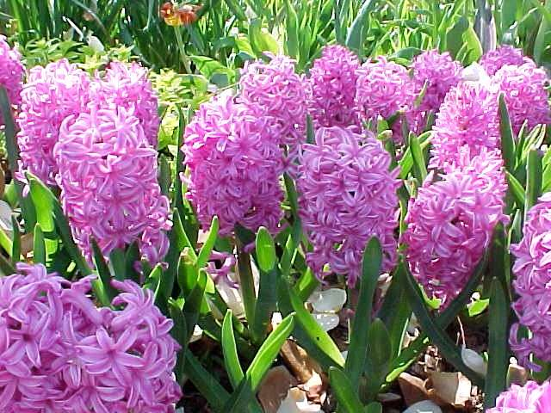
Hyacinthus Orientalis groep

Slide 10
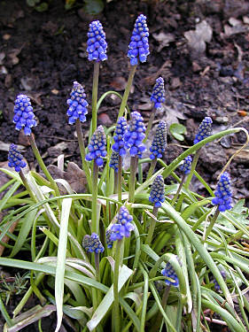
Muscari armeniacum

Slide 11
Muscari latifolium

Slide 12
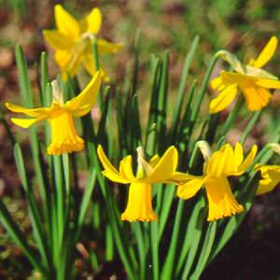
Narcissus 'February Gold'

Slide 13
Narcissus 'Tete a Tete'

Slide 14
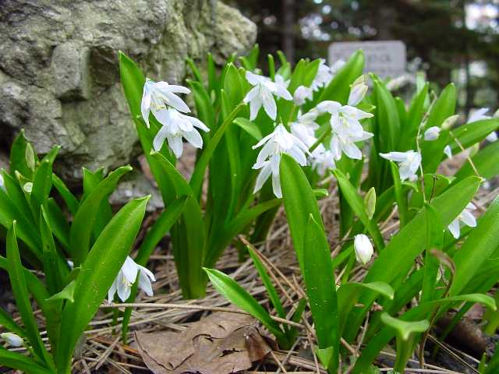
Scilla tubergeniana

Slide 15
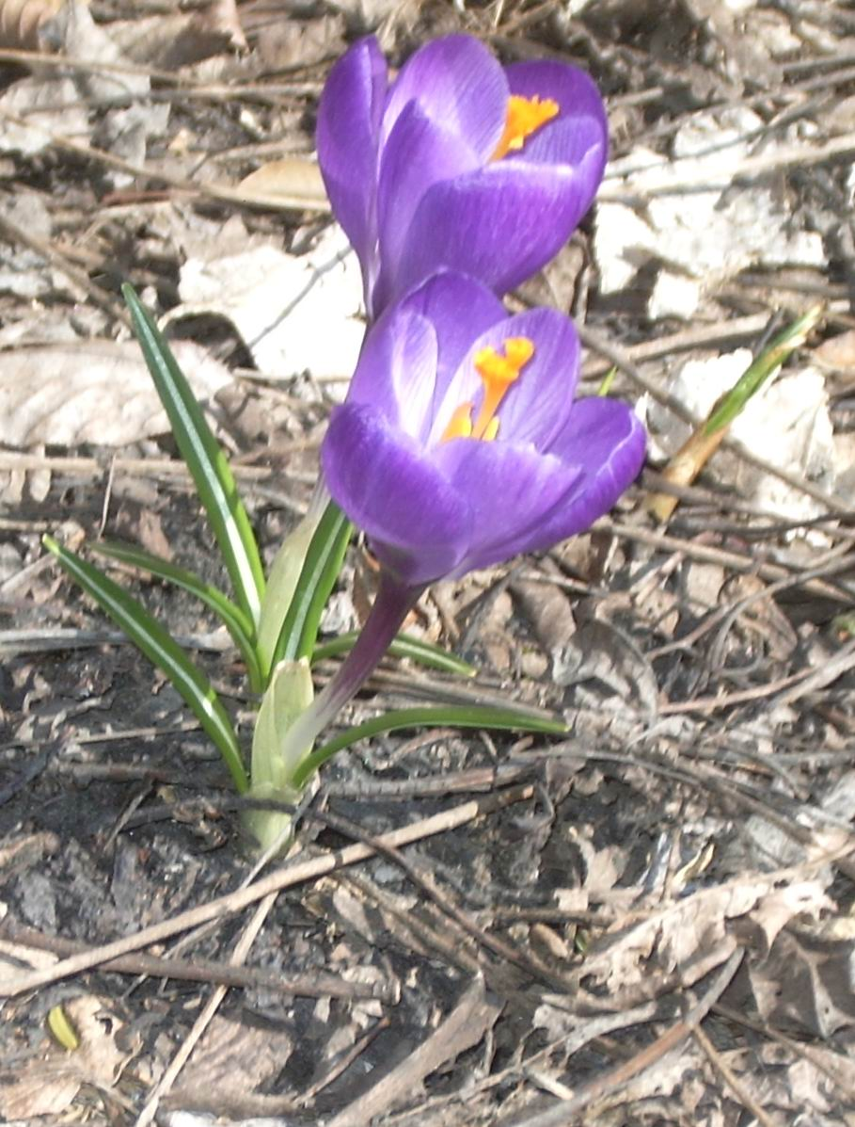
Crocus ‘Remembrance’

Slide 16
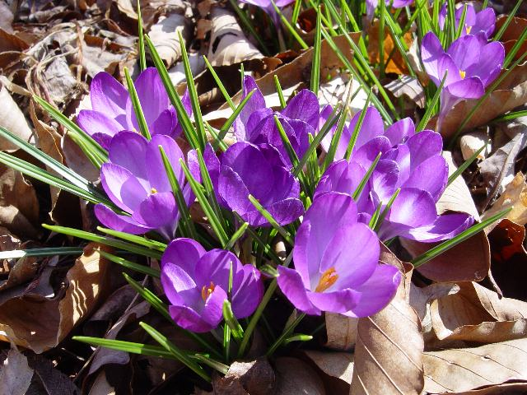
Crocus tommasinianus 'Blue Giant'

Slide 17
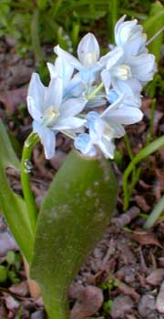
Puschkinia scilloides libanotica

Slide 18
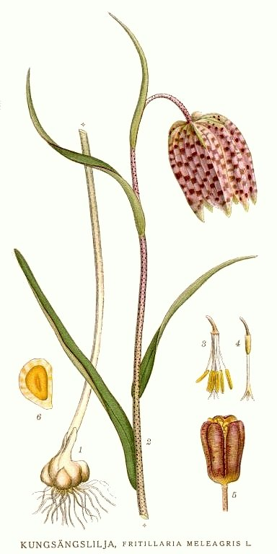
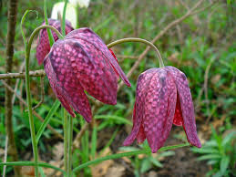
Fritillaria meleagris

Slide 19
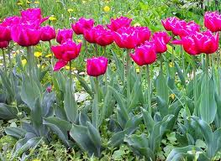
Tulipa

Slide 20
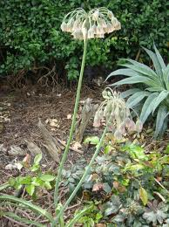
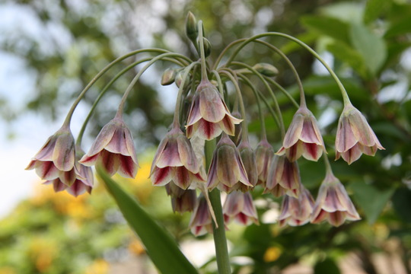
Nectaroscordum siculum

Slide 21
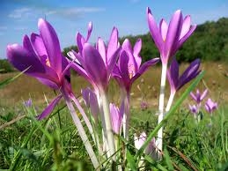
Colchicum autumnale

Slide 22
Einde
Succes!

